Slide 1
Oracle Database 23ai
XML and JSON
Document Convergence

Slide 2
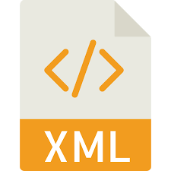
Document formats supported by Oracle Database
XML
Stands for Extensible Markup Language
Defined in 1996 by W3C consortium
Self-descriptive and extensible format
XSLT transformation part of XML standard
Xquery, Xpath languages used to query XML documents
Supported by Oracle Database in XML DB feature
Basic type used to store and process XML data: XMLType
Rich PL/SQL API

Slide 3

Document formats supported by Oracle Database
JSON
Stands for JavaScript Object Notation
Open standard and data interchange format
Data are stored as key:value pairs or in form of arrays
Originally derived from JavaScript
Supported by Oracle Database as a complete data model
Specialized datatypes and data structures
LOB/JSON/JSON_ELEMENT_T
JSON Collection tables/views/duality views
Rich PL/SQL API
MongoDB API available to use Oracle Database as MongoDB JSON specialized database engine

Slide 4
Document format duality Challenges
Different applications use different data formats
Data sharing issues
Lack of single point of truth
High costs of maintenance
Application modernization
JSON is usually considered as more modern standard
JSON is lightweight
Data format not compatible with implemented ETL/ELT processes
Transformations and schemas implemented in XML (XSLT, XML Schemas)
Incoming data in JSON format

Slide 5
Document format duality Solution
Document Format Converter
PL/SQL API allowing for on-the-fly transformation between formats
Implemented in form of object types and packages
Stored in the database – as near to the data as possible
Plays the role of abstraction layer
Makes a document-oriented application totally independent of a data format
Different applications can see the same data in different formats

Slide 6

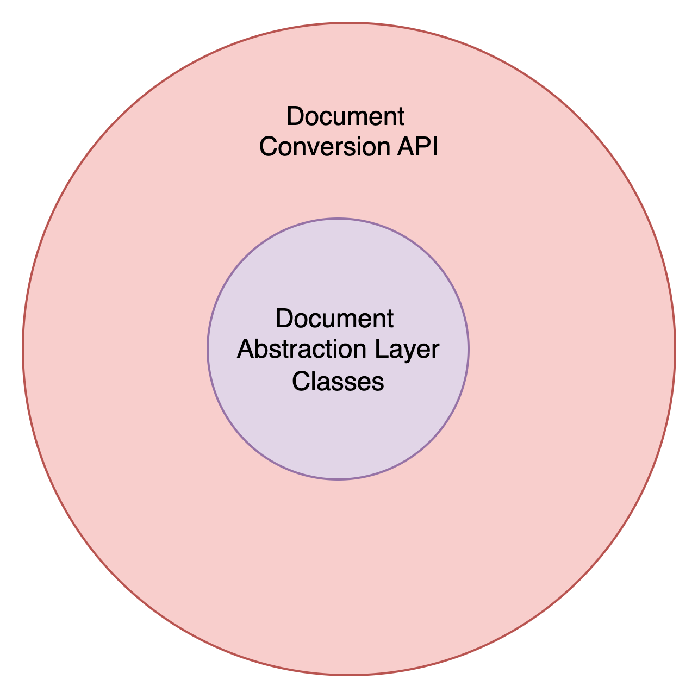
Document Format Converter Architecture

Slide 7
Document Format Converter
Document Abstraction Layer
Low-level interface used to build a layer, which does not depend on specific format
Makes a document-oriented application totally independent of a data format
Different applications can see the same data in different formats
Main components
DocElement
Main class of the interface
Constructors allowing to build object based on XMLType and JSON_ELEMENT_T data
getAsXML and getAsJSON methods
DocAttribute
Allows for storing and processing XML attributes
DOC_CONV_UTL PL/SQL package
Low-level procedures and functions used internally by DocElement and DocAttribute classes

Slide 8
Document Format Converter
Document Abstraction Layer
Example #1: XML to JSON conversion
SQL> set serveroutput on
SQL>
SQL> declare
2 xDoc XMLType := XMLType('<main>
3 <a>val_a</a>
4 <b>val_b</b>
5 </main>');
6 eDoc DocElement := DocElement(xDoc);
7 jDoc JSON_ELEMENT_T := eDoc.getAsJSON;
8 begin
9 dbms_output.put_line(jDoc.to_String);
10 end;
11* /
{"main":{"a":"val_a","b":"val_b"}}

Slide 9
Document Format Converter
Document Abstraction Layer
Example #2: JSON to XML conversion
SQL> set serveroutput on
SQL>
SQL> declare
2 jDoc JSON_ELEMENT_T := JSON_ELEMENT_T.parse('{"a":{"b":"c"}}');
3 eDoc DocElement := DocElement(jDoc);
4 xDoc XMLType := eDoc.getAsXML;
5 begin
6 dbms_output.put_line(xDoc.getClobVal);
7 end;
8* /
<a><b>c</b></a>

Slide 10
Document Format Converter
Document Conversion API
High-level API allowing for easy conversion between supported formats
Basic assumptions
Ease of use
Simplicity
Flexibility
Single PL/SQL package
doc_conv

Slide 11
Document Format Converter
Document Conversion API
DOC_CONV PL/SQL package
SQL> desc doc_conv
FUNCTION JSON2XML RETURNS OPAQUE/XMLTYPE
Argument Name Type In/Out Default?
------------------------- -------------------- ------ --------
JDOC JSON IN
FUNCTION JSON_ELEMENT_T2XML RETURNS OPAQUE/XMLTYPE
Argument Name Type In/Out Default?
------------------------- -------------------- ------ --------
JDOC OBJECT IN
FUNCTION XML2JSON RETURNS JSON
Argument Name Type In/Out Default?
------------------------- -------------------- ------ --------
XDOC OPAQUE/XMLTYPE IN
FUNCTION XML2JSON_ELEMENT_T RETURNS OBJECT
Argument Name Type In/Out Default?
------------------------- -------------------- ------ --------
XDOC OPAQUE/XMLTYPE IN

Slide 12
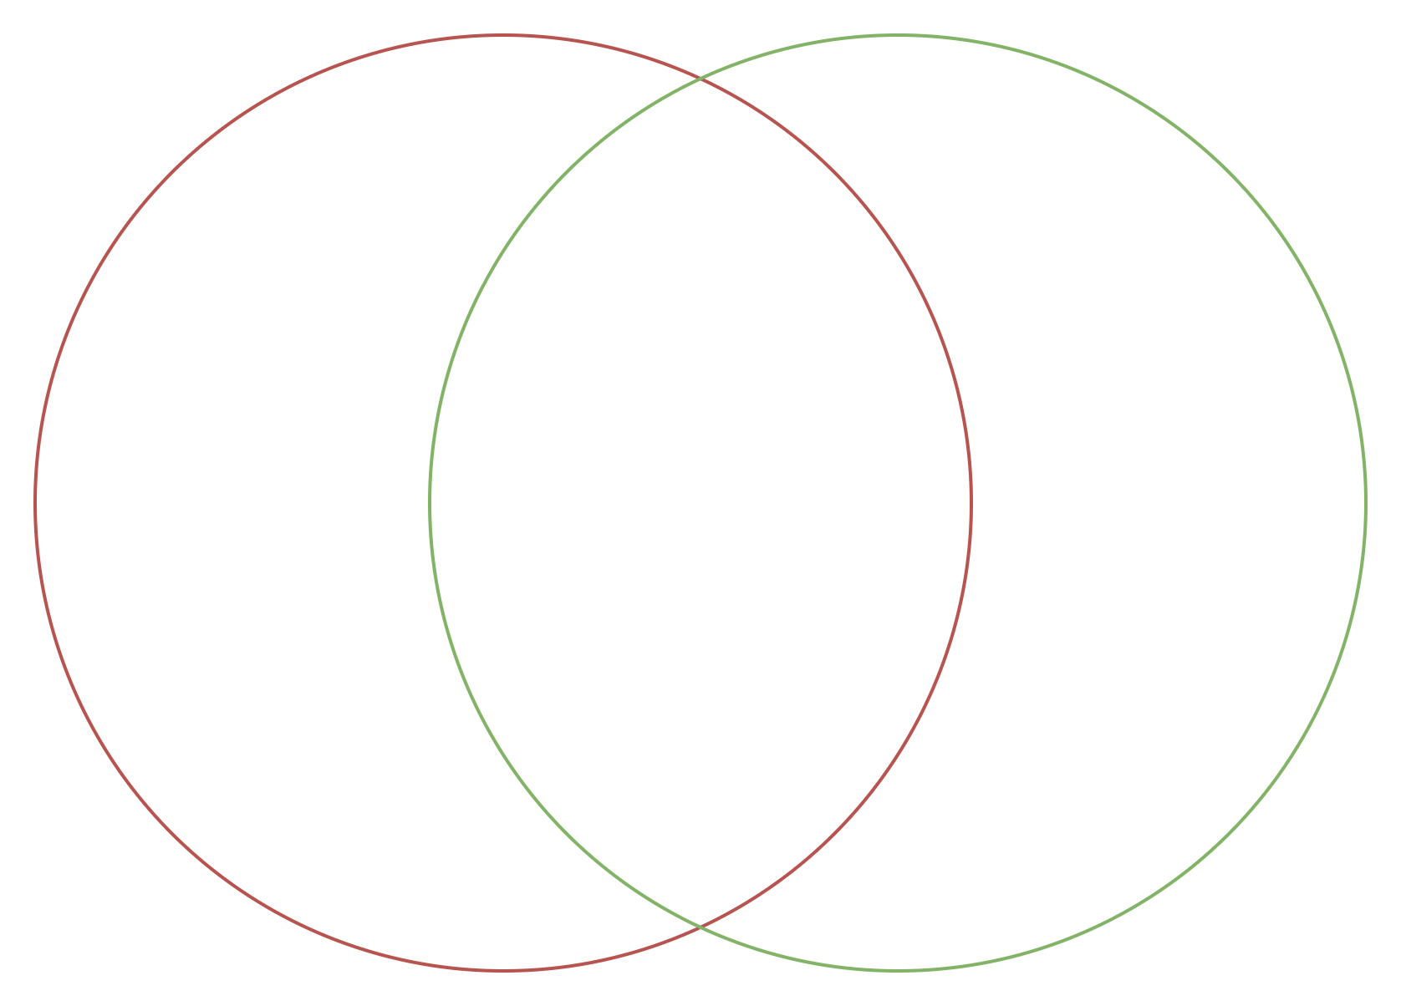
XML vs JSON Challenges
Attributes
Namespaces
XSLT
…
Data
Schemas
Arrays
Objects
…

Slide 13
XML vs JSON Solution
Supplemental Elements
Elements with parametrized values
Added automatically when needed to ensure correct syntax
Example :
SQL> set serveroutput on
SQL> declare
2 jd JSON_ELEMENT_T := JSON_ELEMENT_T.parse('{"key01":"val01","key02":"val02"}');
3 ed DocElement := DocElement(jd);
4 xd XMLType := ed.getAsXML;
5 begin
6 dbms_output.put_line(xd.getClobVal);
7 end;
8* /
<_dc_object_><key01>val01</key01><key02>val02</key02></_dc_object_>
PL/SQL procedure successfully completed

